Slide 1
GIS and Spatial Analytics
Lecture 5

Slide 2
Spatial Overlays
Spatially combine two layers to:
Generate a new output data layer
Assign attributes of one data layer to another
Usually one of the data layers will be polygons
A point-in-polygon overlay is typical

Slide 3
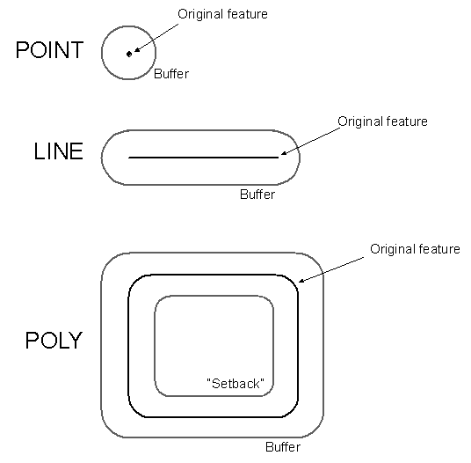
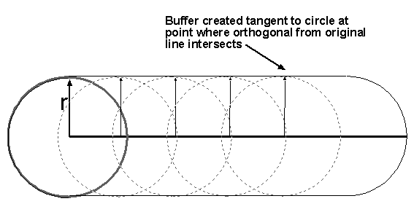
Buffers for Lines and Polygons
Move circle of specified radius along line
(or lines forming polygon)

Slide 4
Examples
In which zip code are survey respondents located? Campaign donors?
In which census tracts do we find Walmart stores? Payday lenders?
How proximate to liquor stores and bars do most crimes occur?

Slide 5
Proximity Tools
Buffer
Multiple Ring Buffer
Near
Point Distance

Slide 6
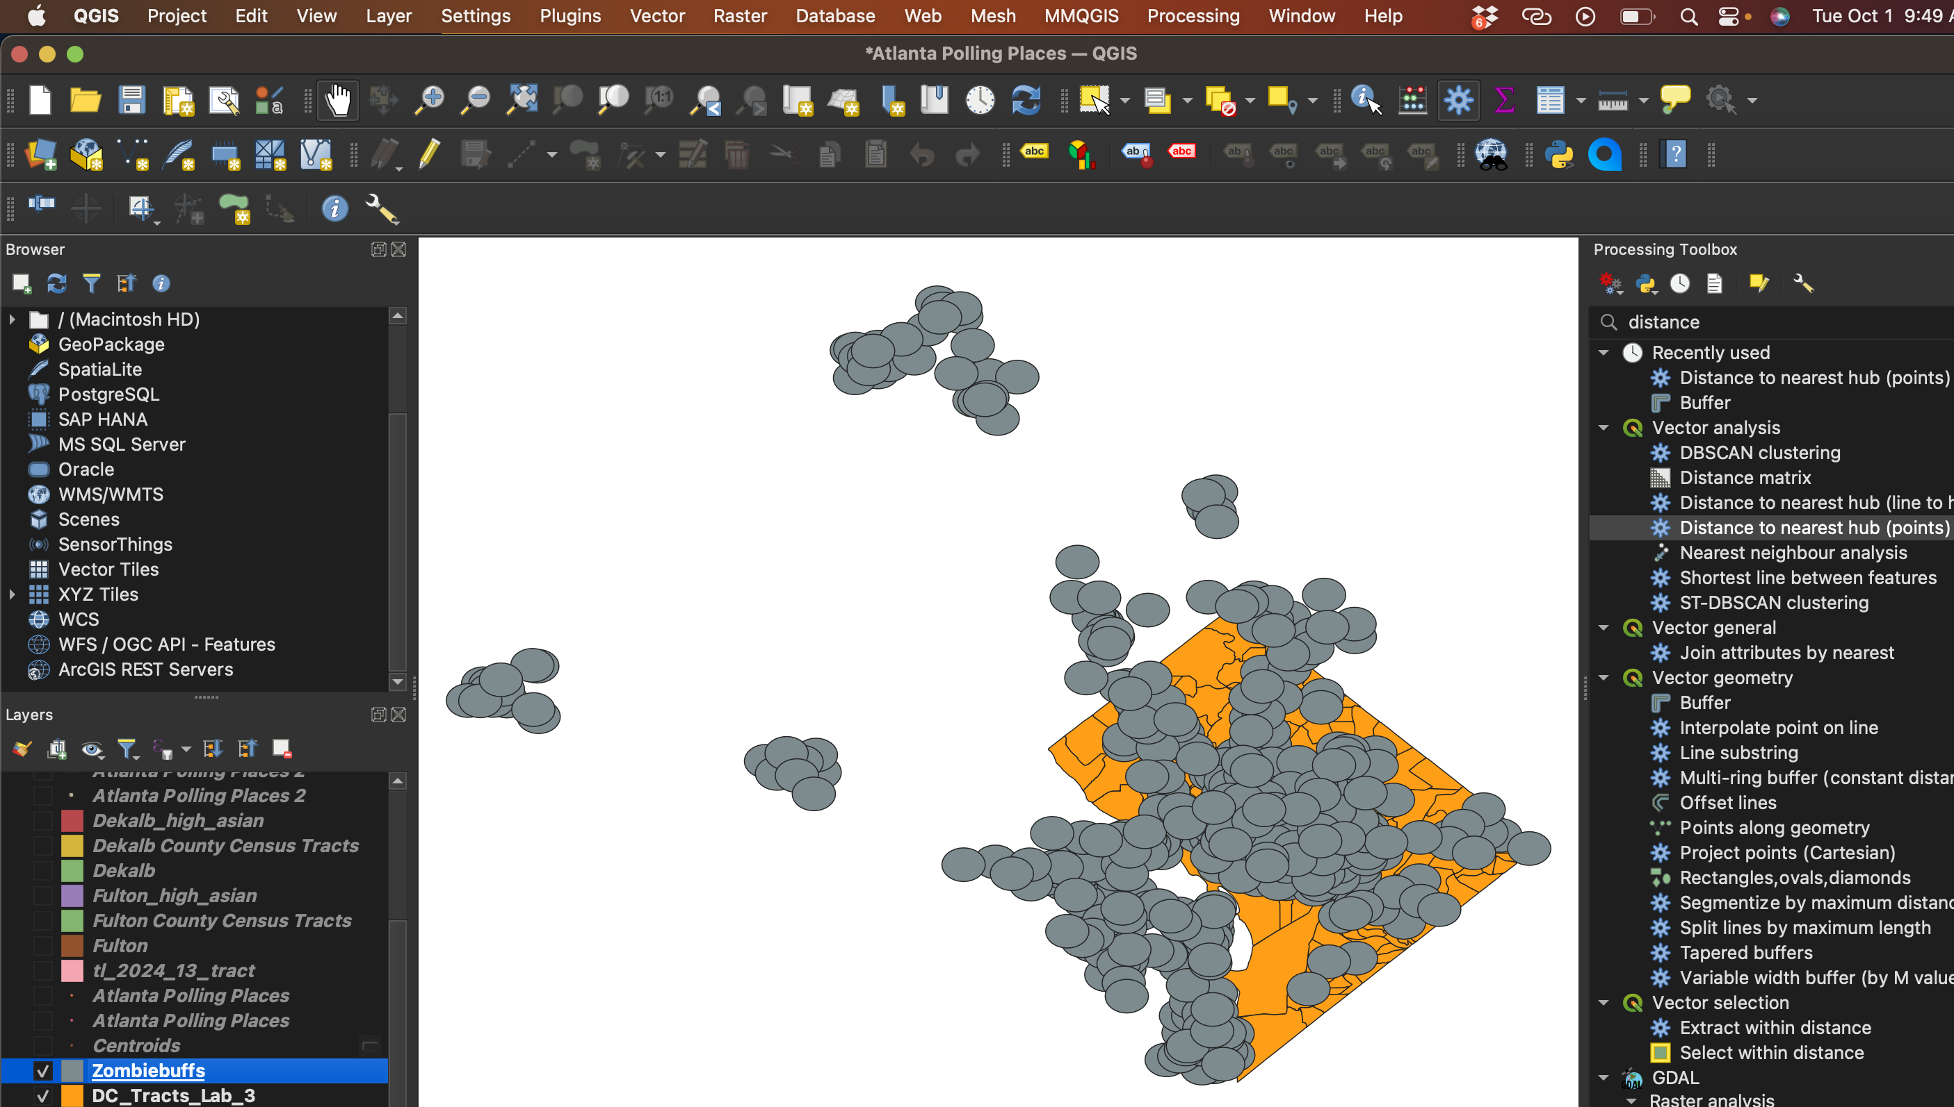

Slide 7
Centroids of Common Shapes
Triangle: The centroid is the point where the medians intersect.
Rectangle: The centroid is at the intersection of the diagonals.
Circle: The centroid is the center of the circle.
Visual: Illustrations of a triangle, rectangle, and circle with centroids marked.

Slide 8
Introduction to Centroids
The centroid is the geometric center of a shape.
It is the point where a shape balances evenly in all directions.
Also referred to as the “center of mass” or “center of gravity.”
Common in fields like geometry, physics, and data science.

Slide 9
Applications of Centroids
Geography: Centroids help in determining the geographical center of regions.
Machine Learning: K-means clustering uses centroids to group data.
Engineering: Used to find the center of gravity in structures.

Slide 10
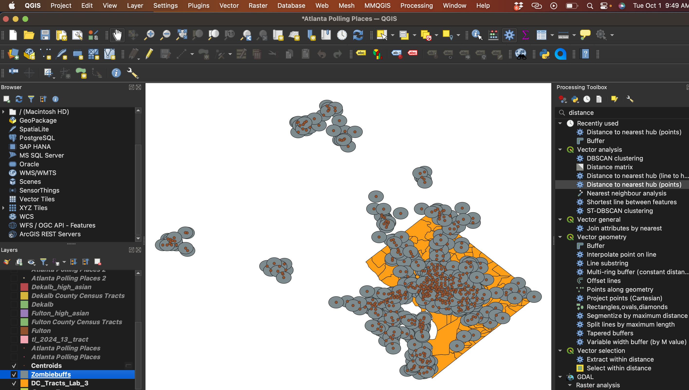

Slide 11
The Process of Geocoding:
Standardizing the address
Searching for potential candidates
Scoring each candidate
Matching address to best candidate

Slide 12
Standardizing the Address
During this step the address is broken into components
For example: street number, street name, street type and street direction

Slide 13
Matching Address to Best Candidate
The geocoding service looks for the potential candidate with the highest score
If the score exceeds the minimum match score setting, then the service matches the address with that candidate

Slide 14
Geocoding Process Settings
Spelling Sensitivity
Minimum Candidate Score
Minimum Match Score

Slide 15
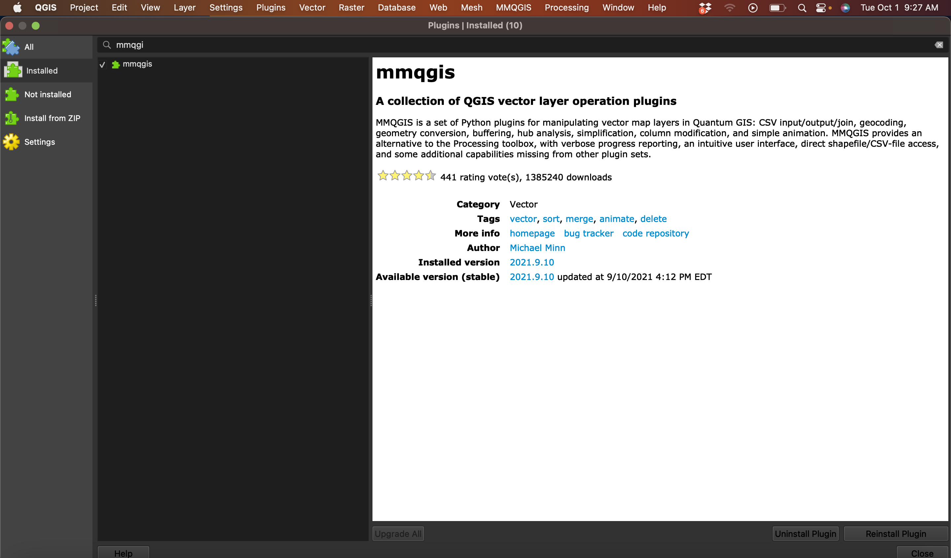
MMQGIS PLUGIN

Slide 16
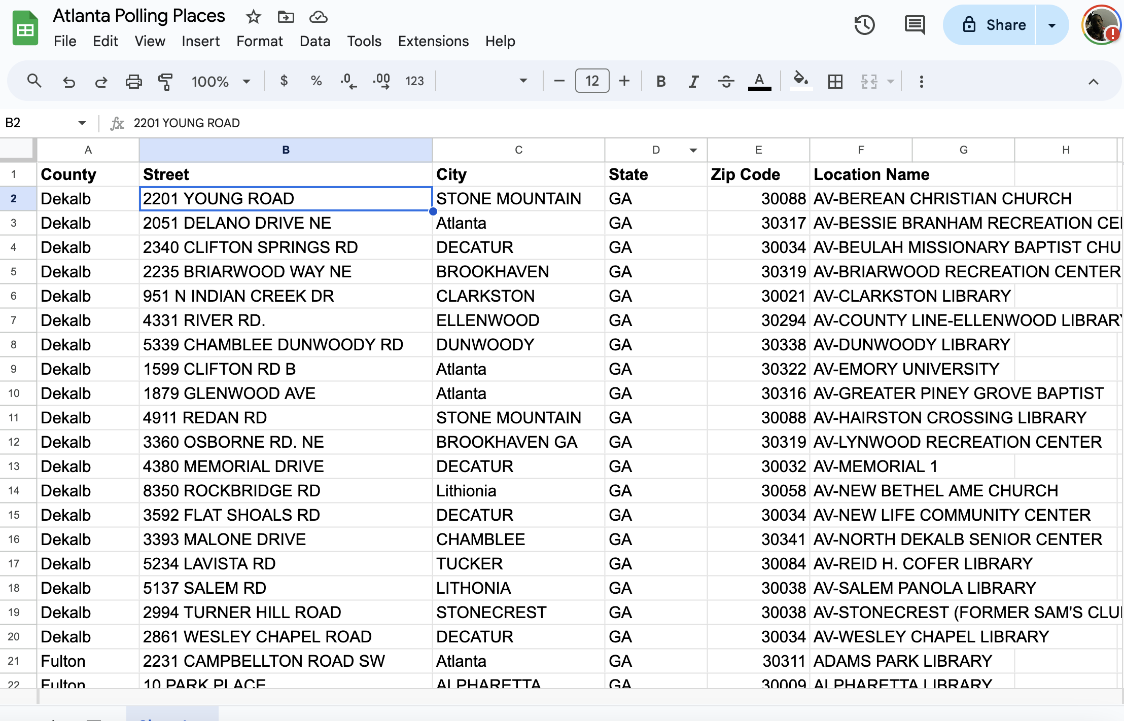
ADDRESSES

Slide 17
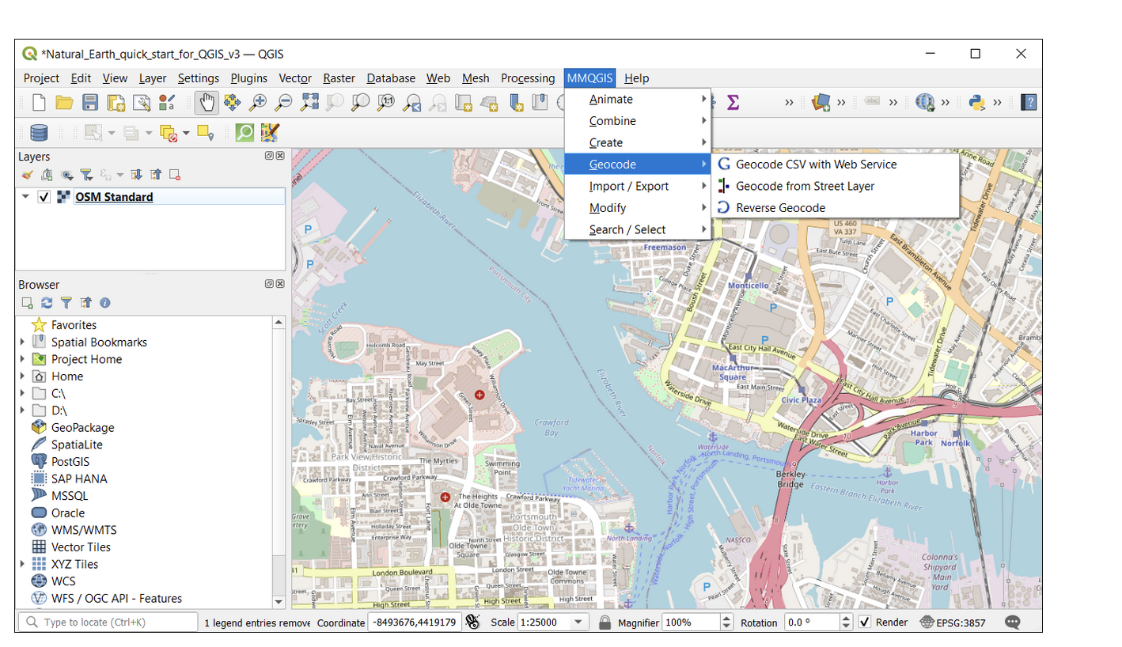

Slide 18


Slide 19
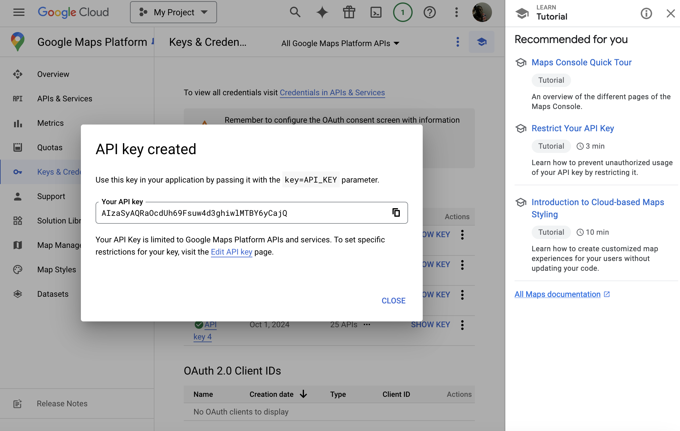

Slide 20
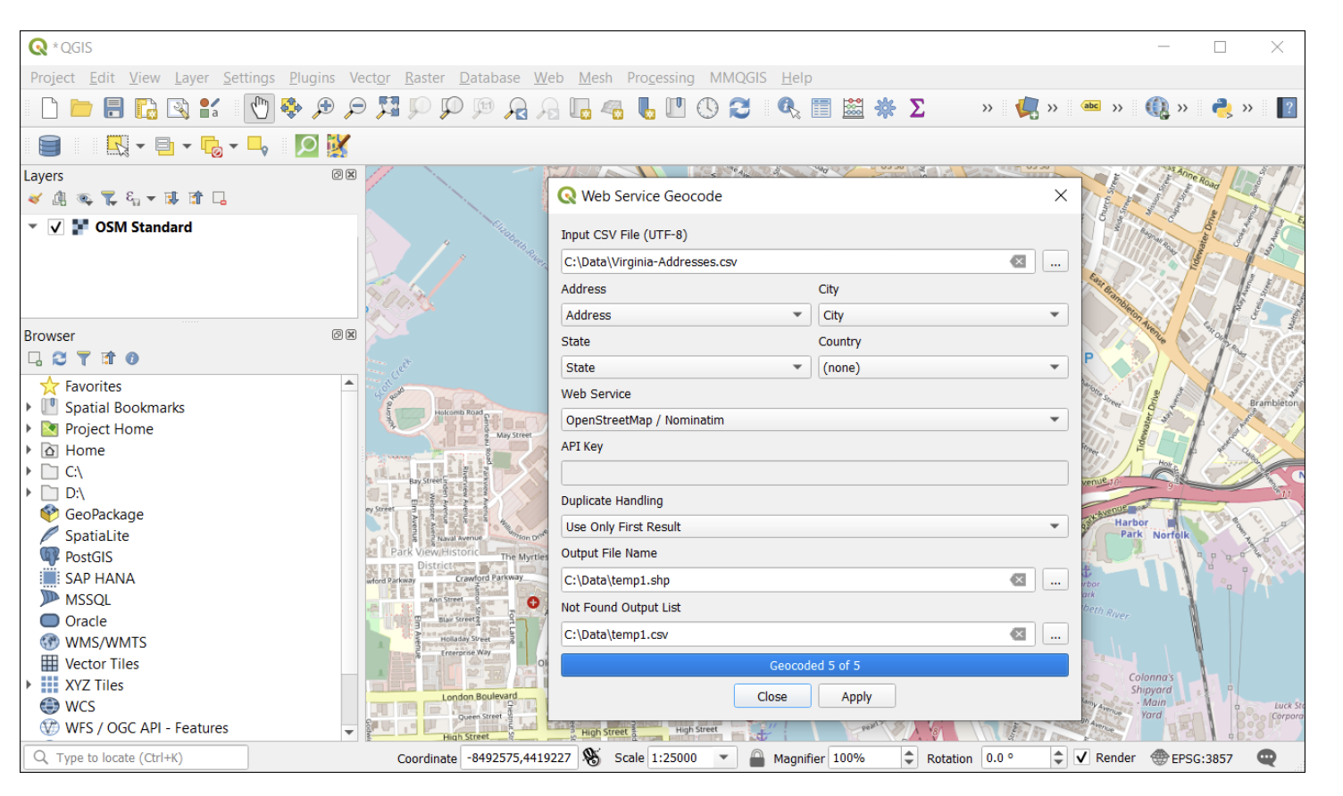

Slide 21
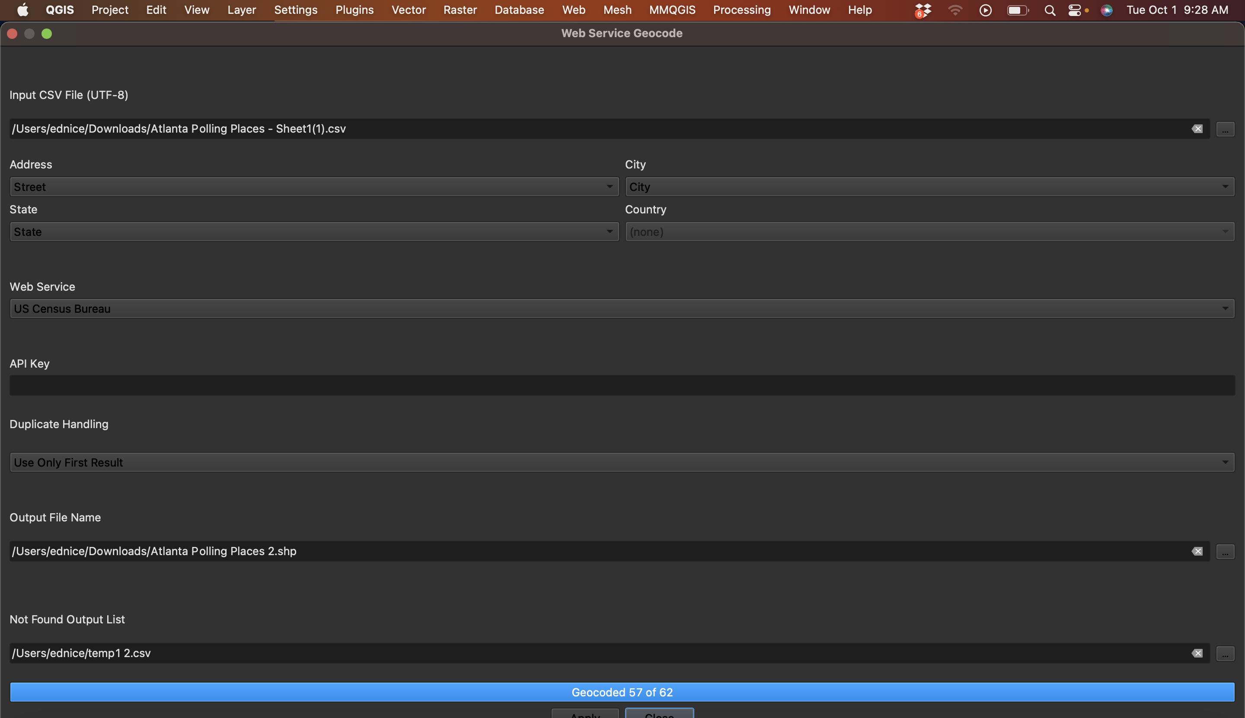

Slide 22
Geocoding
#Tutorial #3: Geocoding in R
Start with R refresher using https://cran.r-project.org/doc/contrib/Torfs+Brauer-Short-R-Intro.pdf
We will return for Geocoding in R at the beginning of next week’s class.

